Slide 1
100 days of coding challenge
DAY 1
NAME-MEGHNA MITRA
REG.NO.-22MCA10043

Slide 2
Given an array of integers nums and an integer target, return indices of the two numbers such that they add up to target. You may assume that each input would have exactly one solution, and you may not use the same element twice. You can return the answer in any order. LINK : https://leetcode.com/problems/two-sum/

Slide 3
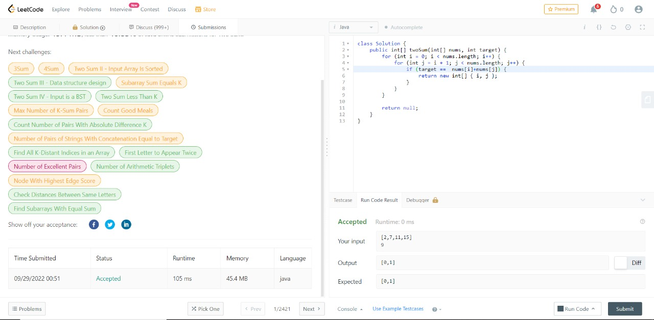
PROGRAM

Slide 4
LEARNING
To implement this problem,first of all,we need to take input
Digits as a key and its index as a value.Then we have to check
the digits if the sum of the digits are return the target value then it will print the index value. If it doesnot give the target value
Then it will return the current digits and complement index.

Slide 5
INTERVIEW QUESTION
1.What is an array?
Array is a collection of similar data types. It can not have different data type. It can hold both primitive types (int, float, double) and object references.
dataType[] arrayVariableName = new dataType[arraySize]; for example for int data type, you can declare an int array as : int[] temp = new int[256]
2. How do you declare an Array in java?

Slide 6
3. Can you change size of Array in java after creation?
You can not change the size of Array after creation. Although there are other data-structures which can change size after creation.
4. Where does Array stored in JVM memory ?
Array is an object in java. So, Array is stored in heap memory in JVM.
5. Which is legal int[] arr or int arr[] ?
Both are legal statements. It is preferred to write int[] arr instead of int arr[].

